Slide 1



aaaaaaa
DevOps project:
Implementation of CI/CD
for Piggy Metrics
Team members:
Alejandro Valderrama
Edgar Mendoza
Omar Santoyo
11/29/2021

Slide 2

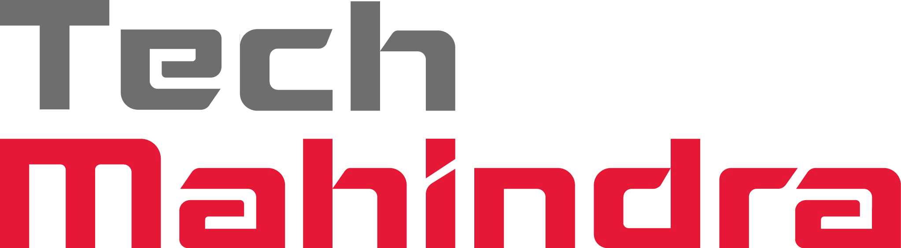
Piggy Metrics app
Why DevOps?
DevOps strategy
Tools & demos
CI/CD
Branching strategy
Pipeline demo
QA
Content

Slide 3
Piggy Metrics
Piggy Metrics is a Microservice Architecture financial advisor app
Piggy Metrics gives us the ability to:
Performs calculations on major statistics parameters
Capture time series
Stores user contact information, incomes/expenses items, savings and notification setting

Slide 4
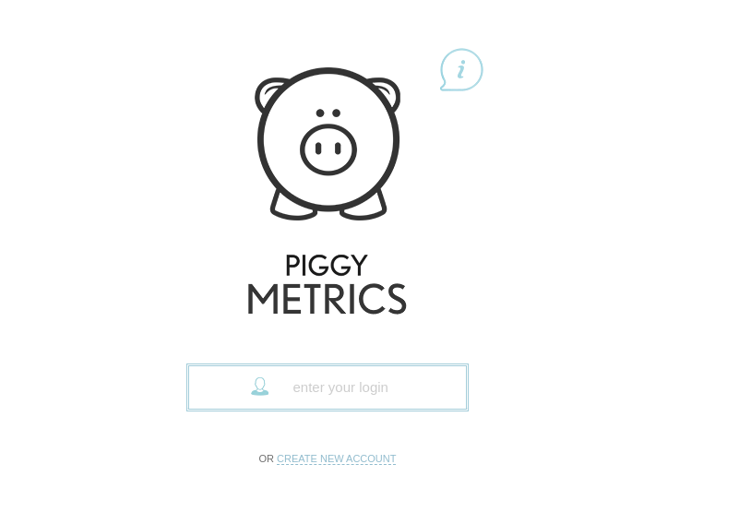
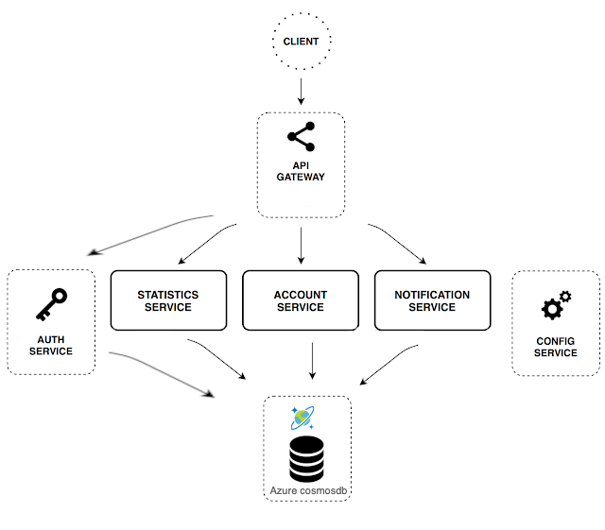
Piggy Metrics Architecture
Account Service: Contains general input logic and validation: incomes/expenses items, savings and account settings
Statistics Service: Performs calculations on major statistics parameters and captures time series for each account
Notification Service: Stores user contact information and notification settings (reminders, backup frequency, etc.)
Auth Service: Stores the authentication data into the database
Config Service: Configures the spring framework used to enable the integration of all the other services

Slide 5

Our customers believe that it is crucial for their business to focus on rapid value creation so that they can offer users value as quickly as possible.
Why DevOps?
What We will be delivering to our customer:
Release deliverables more frequently, with higher quality and stability
Stabilize work environment
Continuous delivery of software
Automation in repetitive tasks leaves more room for innovation
Promotes agility in the business

Slide 6

Terraform is used to provision the infrastructure needed
Azure Cloud is our pick for cloud provider
Docker to build containerized images
AKS to host the Kubernetes cluster
Extensible testing in our pipeline using GitHub actions
Helm to deploy our application
DevOps strategy
Adaptable
Robust
Quick and easy develop
Cycle that can deploy fast
Distributed Architecture
Scalable
Easy to scale using
Kubernetes and AKS
Easy Maintenance
Deploy new changes
Is easy and automatic
Easy provisioning
Modifications trouble-free

Slide 7

Terraform
Azure infrastructure
Docker
Jib
Helm
AKS
Vault
DevOps tools & demos

Slide 8

We use terraform to provision our infrastructure:
Terraform is an open-source infrastructure as code software tool created by HashiCorp
Users define and provide data center infrastructure using a declarative configuration language known as HashiCorp Configuration Language (HCL)
Terraform

Slide 9
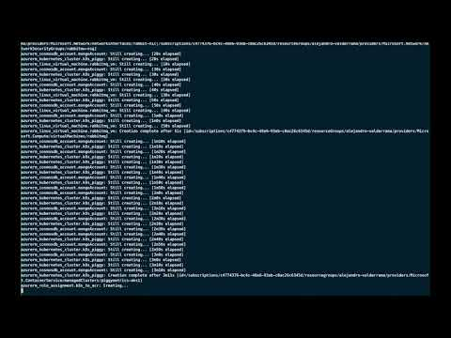
Demo terraform

Slide 10
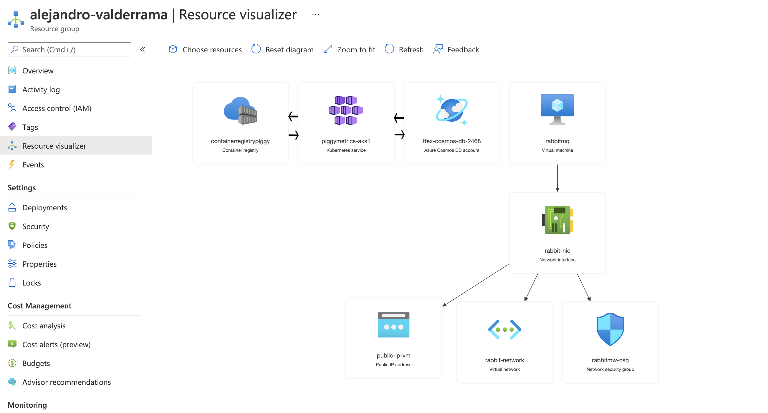
The piggymetrics infrastructure in Azure

Slide 11
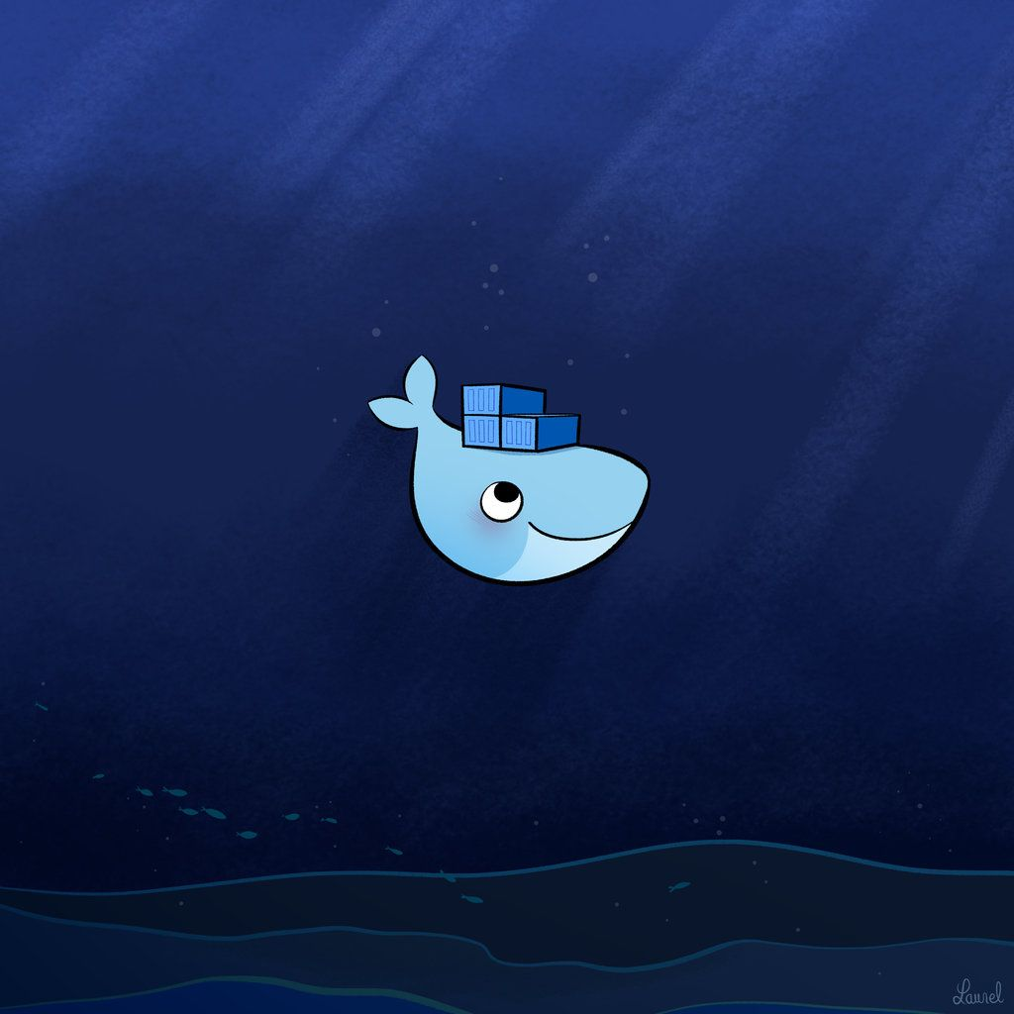
Docker is an open source
containerization platform:
Docker provides the ability to package and run an application in a loosely isolated environment called a container
Docker simplifies and accelerates the workflow, while giving developers the freedom to innovate with their choice of tools, application stacks, and deployment environments
Docker

Slide 12
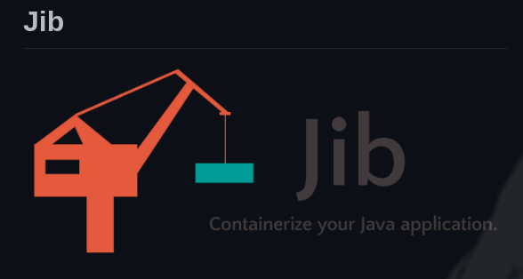
Jib is used to build our containers
Jib builds optimized Docker and OCI images for your Java applications without a Docker daemon - and without deep mastery of Docker best-practices. It is available as plugins for Maven and Gradle and as a Java library.
Fast
Reproducible
Daemonless

Slide 13
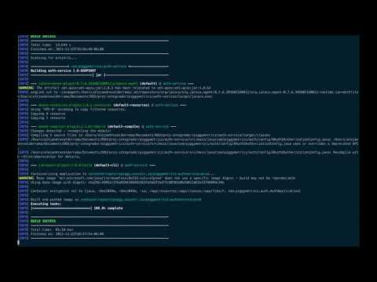
Demo docker

Slide 14
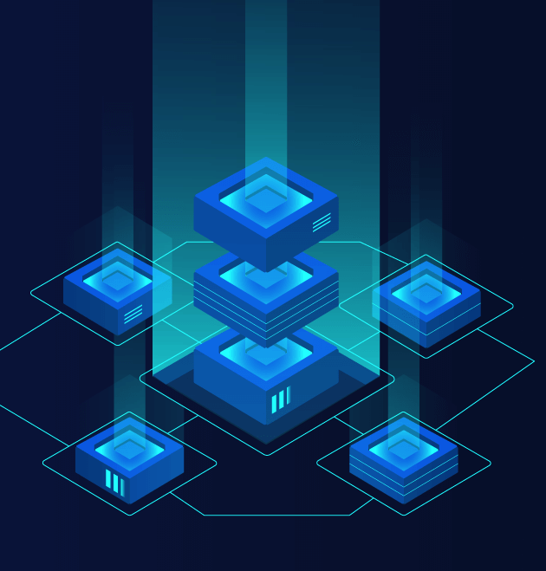
We use Helm to quickly deploy the changes to the application:
Helm helps combine multiple Kubernetes manifests (yaml) into a single unit called Helm Charts
Helm gives the ability to customize application configurations during deployment
Helm

Slide 15
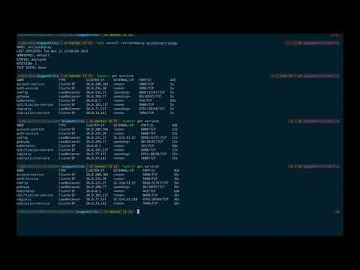
Demo helm

Slide 16
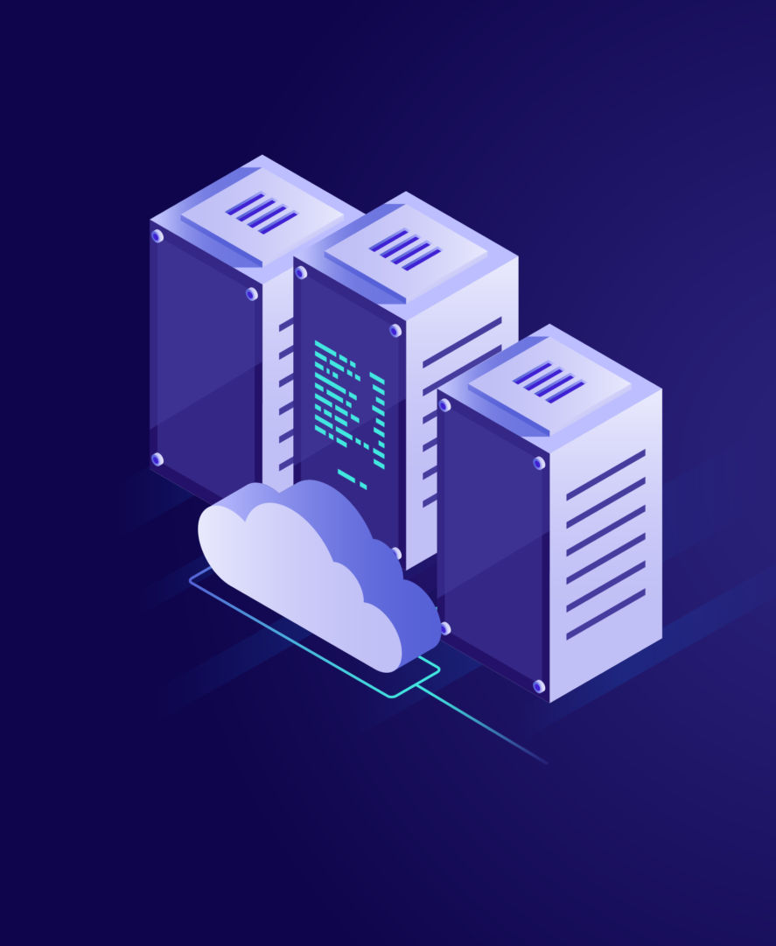
Azure Kubernetes Service is a managed container orchestration service based on the open-source Kubernetes system
An organization can use AKS to handle critical functionality such as deploying, scaling and managing Docker containers and container-based applications
Azure Kubernetes Service (AKS)

Slide 17
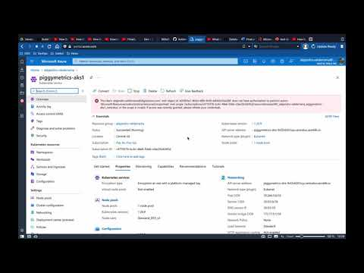
Demo AKS

Slide 18

Vault is a secrets management tool specifically designed to control access to sensitive credentials
It can be used to store sensitive values and at the same time dynamically generate access for specific services/applications on lease
Vault

Slide 19
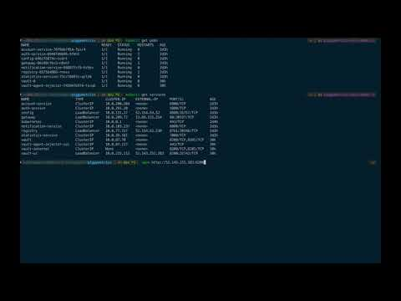
Demo vault

Slide 20

CI/CD
Branching strategy
Github actions
CI/CD pipeline using github actions

Slide 21

CI/CD bridges the gaps between development and operation activities and teams by enforcing automation in building, testing and deployment of applications.
Use automation to reduce the time, effort, and risk involved in shipping a release.
We use various pipelines that get trigger with either push or pull request in some branches.
CI/CD

Slide 22
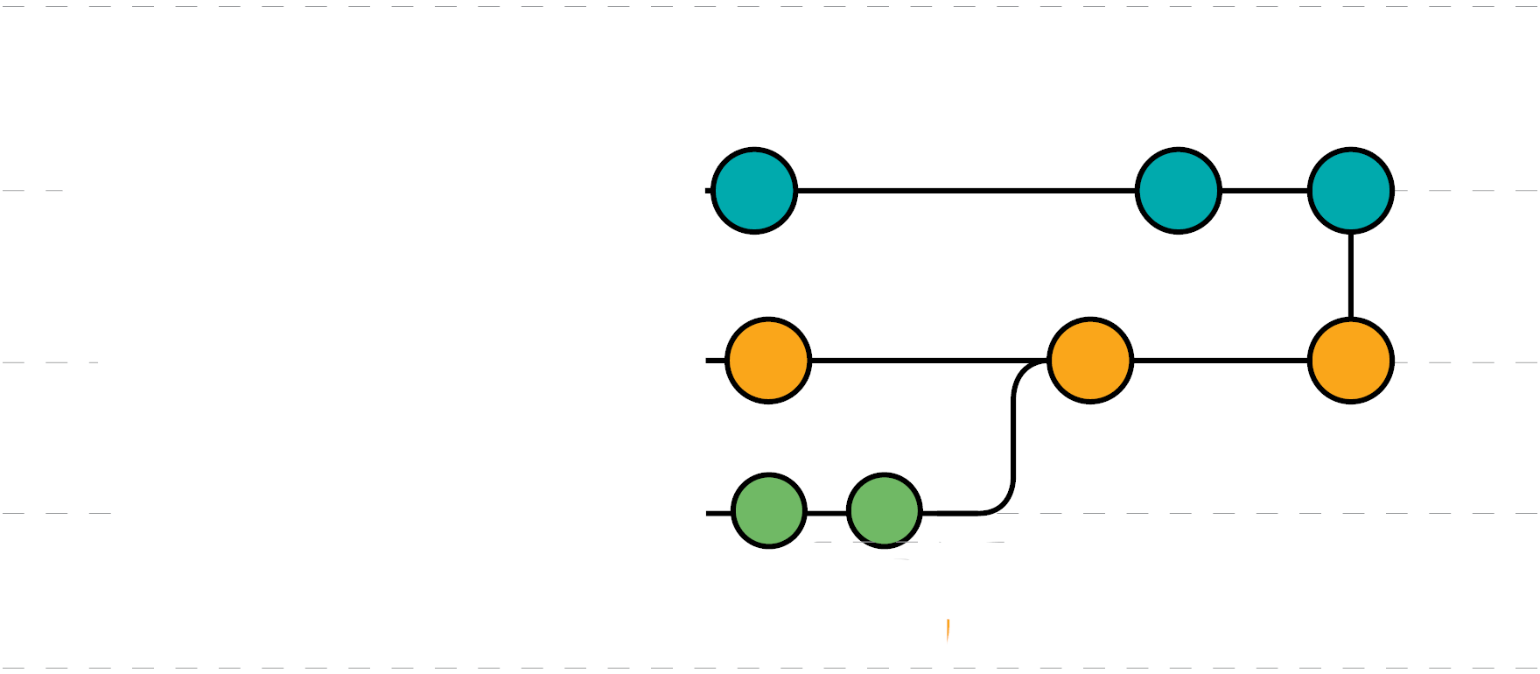
We propose a branching strategy that:
Uses to main branches dev and master
The master branch is always deployable.
Push to other the dev occurs constantly
Branching Strategy

Slide 23
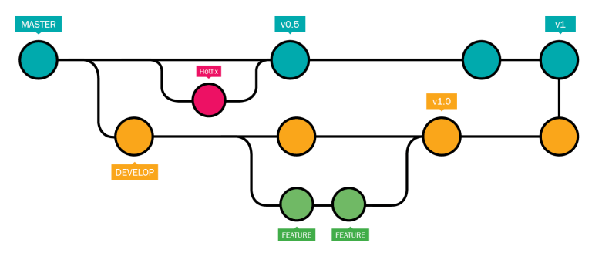
Branching strategy for Piggy Metrics.

Slide 24
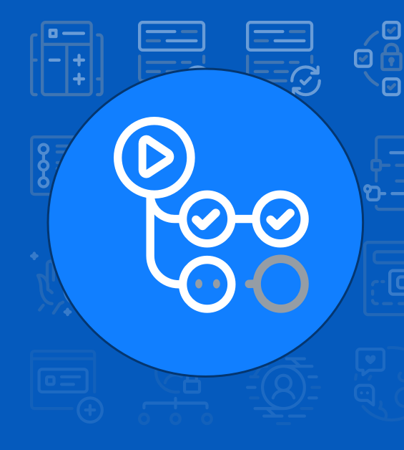
GitHub Actions allow to create workflows that automatically build, test, publish, release, and deploy code:
These workflows are made out of different tasks so-called actions that can be run automatically on certain events
GitHub Actions

Slide 25
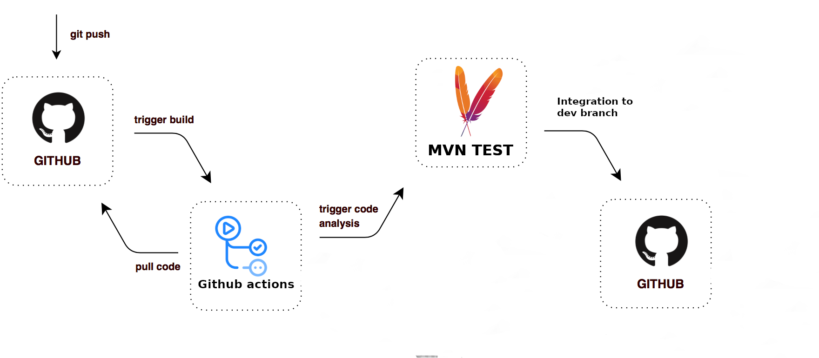
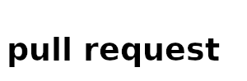
From a new feature to dev

Slide 26
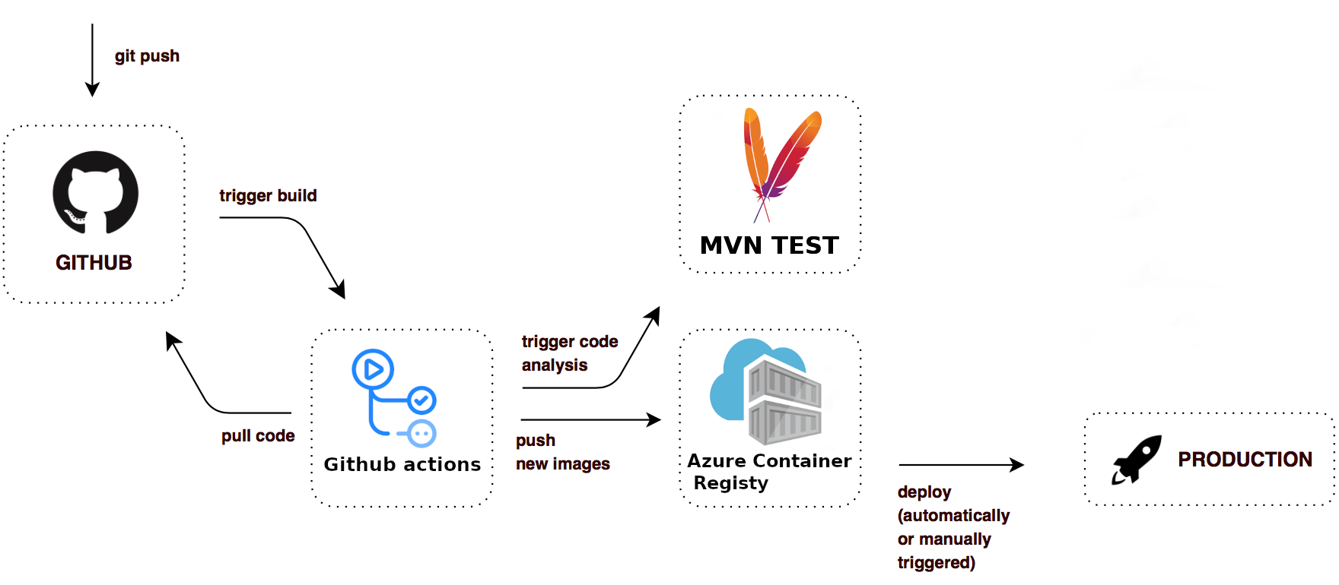
Pull request to master

Slide 27
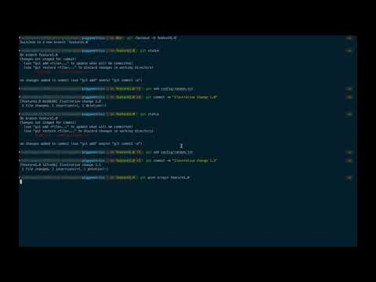
Demo feature-dev

Slide 28
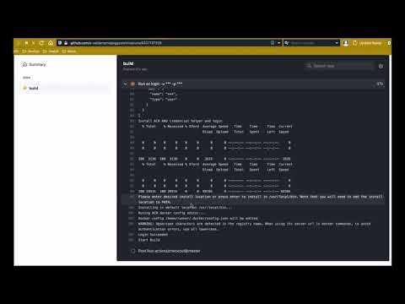
Demo dev-prod

Slide 29
What's next for Piggy Metrics
Create a testing environment that deploys the changes added to the dev branch each time a pull request is accepted.
Implement policies for enabling merging into dev and master branches.
Add monitoring for the pods in AKS.
Integrate vault secrete engine to interact with the CosmosDb database.

Slide 30
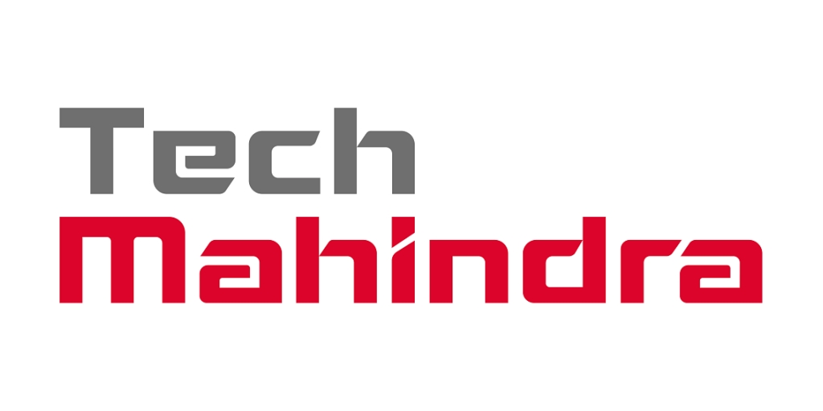
Q&A

Slide 31
Thank you
Visit us at www.techmahindra.com

